Slide 1
Git, Github, and Github Desktop
A better way

Slide 2
Outline
What is it?
Why should I?
How do I?

Slide 3
What is it?
git = Version control software
Stores the state history of your project (in a “repository”)
Every time you “commit” some changes, a new state is stored.
Also allows synchronizing your project “repository” with other computers!
Has other fancy capabilities like branching and merging, resetting, releases,
GitHub = Popular centralized place to store/share git repositories
GitHub Desktop = a GUI wrapper for git
Use the basic features of git without a big learning curve!

Slide 4
Why should I?
The way we do things works ok!
There are a constellation of headaches that git/GitHub Desktop can solve for us fairly easily.

Slide 5
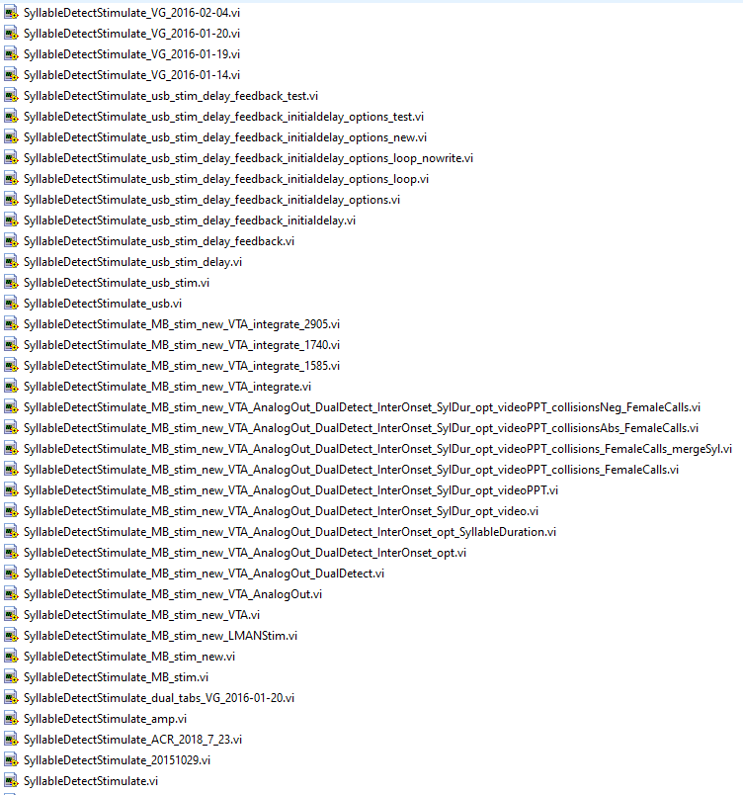
Current state of affairs
We create code
Several people work with it at once on different computers
Versions get slacked, e-mailed, stored in network folders
Naming schemes build up like geological layers, sometimes they reflect what’s in the code, sometimes they don’t
Problems arise:
Which one is the latest version? When was this version made? Who made it? What’s different about these two versions? Which version has that one feature I need? I made a mistake in this code! How do I go back to a previous state?! How do I make my code available for publication?

Slide 6
How do i?
Let’s
Install GitHub Desktop
Clone a repository with some MATLAB code on GitHub
Run the code
(I’ll make a change to the code)
Pull updated code from GitHub
Run the updated code

